Slide 1

POLYTECHNIC UNIVERSITY OF THE PHILIPPINES
INSTITUTE OF TECHNOLOGY
Project Management
COMP 40013
Prepared by
Prof. Camilo P. Abogado
MM-Public Service Management

Slide 2
Module 4
Integration Management

Slide 3
UNIT III Integration Management
Overview
This module discusses the project management integration processes.
It presents the description of integration management and its underlying processes such as creation of project charter, project management plan and monitoring and controlling the project as well as the performing integrated change control and lastly closing the project.

Slide 4
Lesson 10
Definition of Integration Management

Slide 5
Learning Outcomes:
After successful completion of this lesson, you should be able to:
• Describe an overall framework for project integration management as it relates to the other project management knowledge areas and the project life cycle.

Slide 6
Learning Outcomes:
After successful completion of this lesson, you should be able to:
• Discuss the strategic planning process and apply different project selection methods.

Slide 7
Learning Outcomes:
After successful completion of this lesson, you should be able to:
• Explain the importance of creating a project charter to formally initiate projects.

Slide 8
Course Materials:
Definition of Integration Management
Includes the processes and activities to identify, define, combine, unify, and coordinate the various processes and project management activities within the Project Management Process Groups.
Involves coordinating all of the other project management knowledge areas throughout a project’s life cycle.
Ensures that all the elements of a project come together at the right times to complete a project successfully.

Slide 9
Seven Main Processes Involved in Project Integration Management
Developing the project charter
2. Developing the project management plan
3. Directing and managing project work
4. Managing project knowledge
5. Performing integrated change control
6. Closing the project or phase
Notes:
Developing the project charter involves working with stakeholders to create the document that formally authorizes a project—the charter.
Developing the project management plan involves coordinating all planning efforts to create a consistent, coherent document—the project management plan.
Directing and managing project work involves carrying out the project management plan by performing the activities included in it.
Managing project knowledge involves using existing knowledge and creating new knowledge to achieve project
Monitoring and controlling project work involves overseeing activities to meet the performance objectives of the project.
Performing integrated change control involves identifying, evaluating, and managing changes throughout the project life cycle.
Closing the project or phase involves finalizing all activities to formally close the project or phase

Slide 10
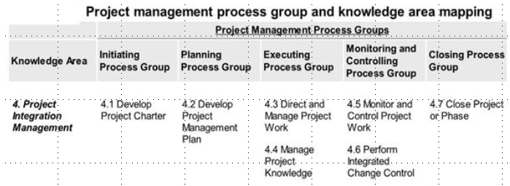

Slide 11
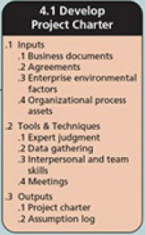
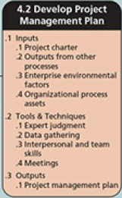
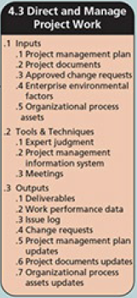
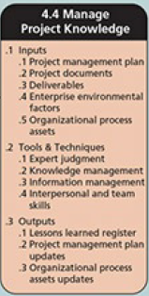
Project Integration Management Overview

Slide 12
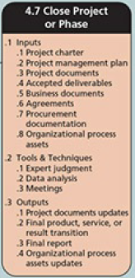
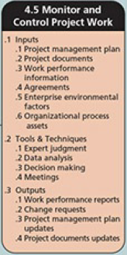
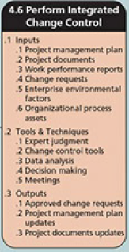
Project Integration Management Overview

Slide 13
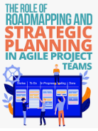
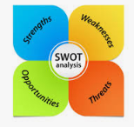
Strategic Planning Process
Strategic planning involves determining long-term objectives by analyzing the strengths and weaknesses of an organization, studying opportunities and threats in the business environment, predicting future trends, and projecting the need for new products and services.
Strategic planning provides important information to help organizations identify and then select potential projects.

Slide 14
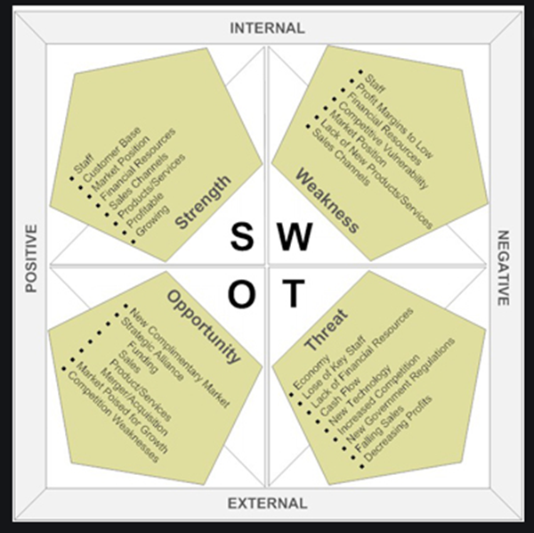
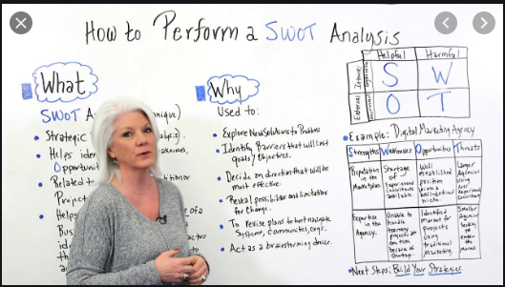
The SWOT Analysis
SWOT analysis is analyzing Strengths, Weaknesses, Opportunities, and Threats

Slide 15
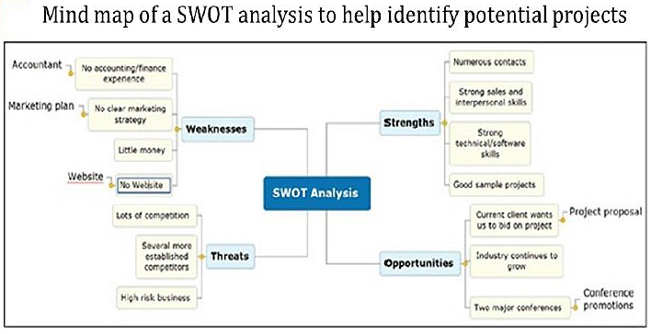

Slide 16
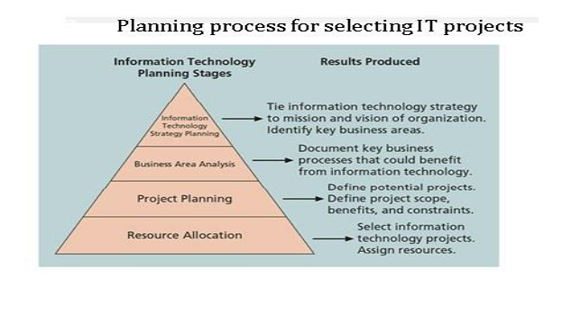

Slide 17
Developing the Project Charter
Develop Project Charter is the process of developing a document that formally authorizes the existence of a project and provides the project manager with the authority to apply organizational resources to project activities.
The key benefit of this process is a well-defined project start and project boundaries, creation of a formal record of the project, and a direct way for senior management to formally accept and commit to the project.

Slide 18
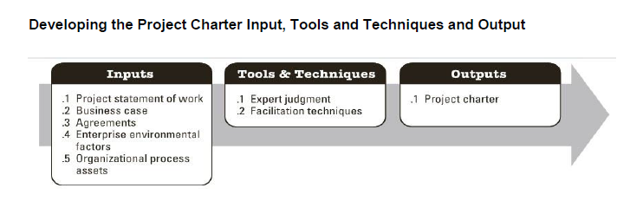

Slide 19
The Project Charter
A project charter is a document that formally recognizes the existence of a project and provides direction on the project’s objectives and management. It authorizes the project manager to use organizational resources to complete the project.

Slide 20
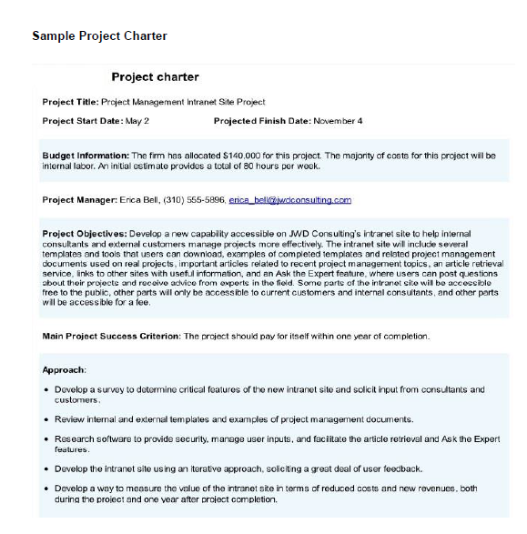
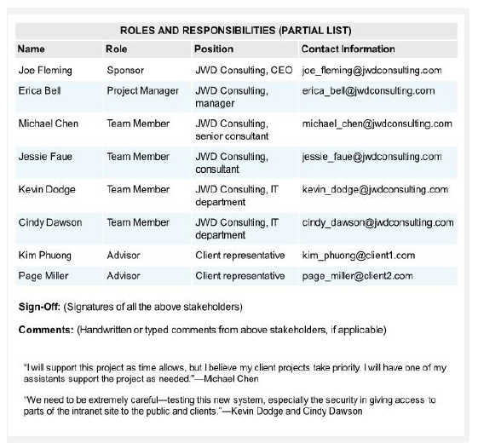

Slide 21
Importance of Project Charter
Many projects fail because of unclear requirements and expectations, so starting with a project charter makes a lot of sense.
If project managers are having difficulty obtaining support from project stakeholders, for example, they can refer to the agreements listed in the project charter.

Slide 22
Here is a sample of a detailed project charter for a Human Resource Information
System Project.
Project Charter Template 1
Project Charter Template 2
Sample Project Management Plan 1

Slide 23
Read:
Chapter 4 Information Technology Project Management 9th Edition Kathy Schwalbe
Chapter 4 Guide to the Project Management Body of Knowledge (6th edition) (PMBOK® Guide) – Sixth edition

Slide 24
Activities/Assessment:
Activities/Assessment:
Which of the following processes is not part of project integration management?
a. Developing the project business case
b. Developing the project charter
c. Developing the project management plan
d. Closing the project or phase

Slide 25
Problem:
• Describe the project integration management. How does it relate to the project life cycle, stakeholders, and the other project management knowledge areas?
• Summarize key work involved in each of the seven processes of project integration management.

